Slide 1
Week 07
Keel Bone Chicken Project
10/03/2025

Slide 2
This Week
Progress & issues faced this week
Got Bluetooth Connection working over Nicla
Set up and soldered development board
Tested remote operation of BLE
Schematic changes

Slide 3
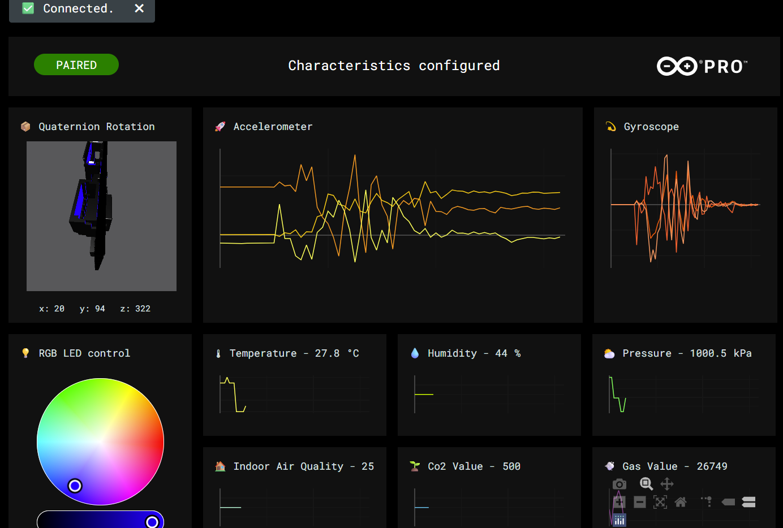
Bluetooth Connectivity
Able to connect with Arduino Nicla Sense over Bluetooth
Compile basic BLE functionality monitor
Review GitHub repository to make modifications for specific application
https://github.com/arduino/ArduinoAI
Able to view on Web Browser:
https://arduino.github.io/ArduinoAI/NiclaSenseME-dashboard/
https://docs.arduino.cc/tutorials/nicla-sense-me/web-ble-dashboard/

Slide 4
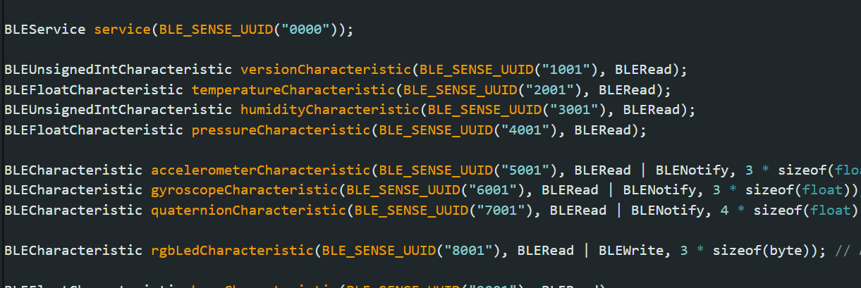
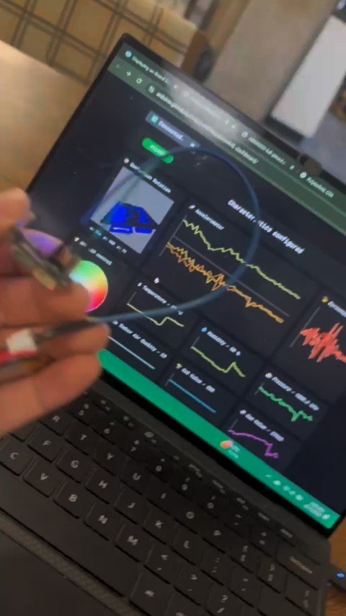
Battery
Battery Implemented for Remote Operation with Nicla Sense
Arduino code (implemented)
Remote battery operation tested

Slide 5
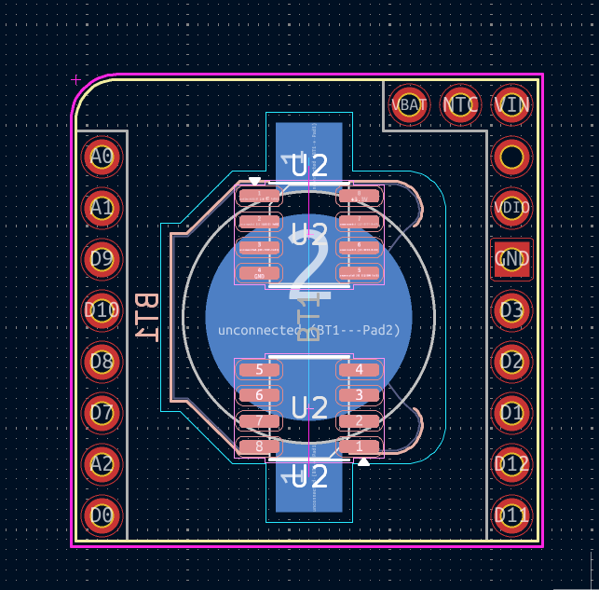
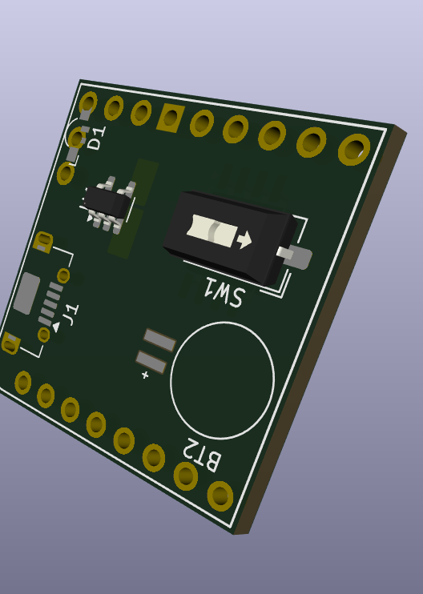
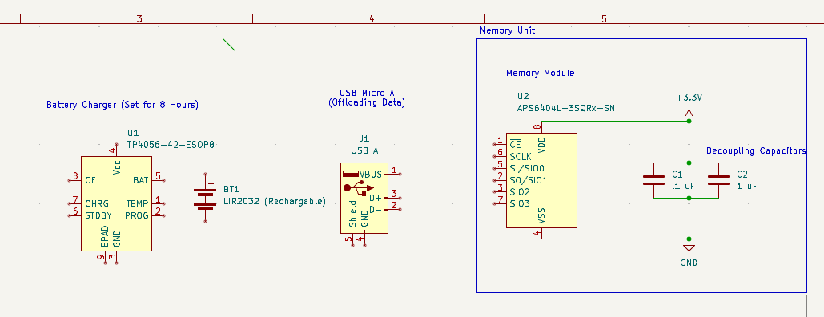
Schematic Changes
Added Rechargeable Battery IC Circuit + 64 MB Flash Memory
New Battery Management IC: TP4056 (Lifetime during charges ~10 hrs)
New Flash IC: APS6404L-3SQR QSPI PSRAM
Layout & Schematic

Slide 6
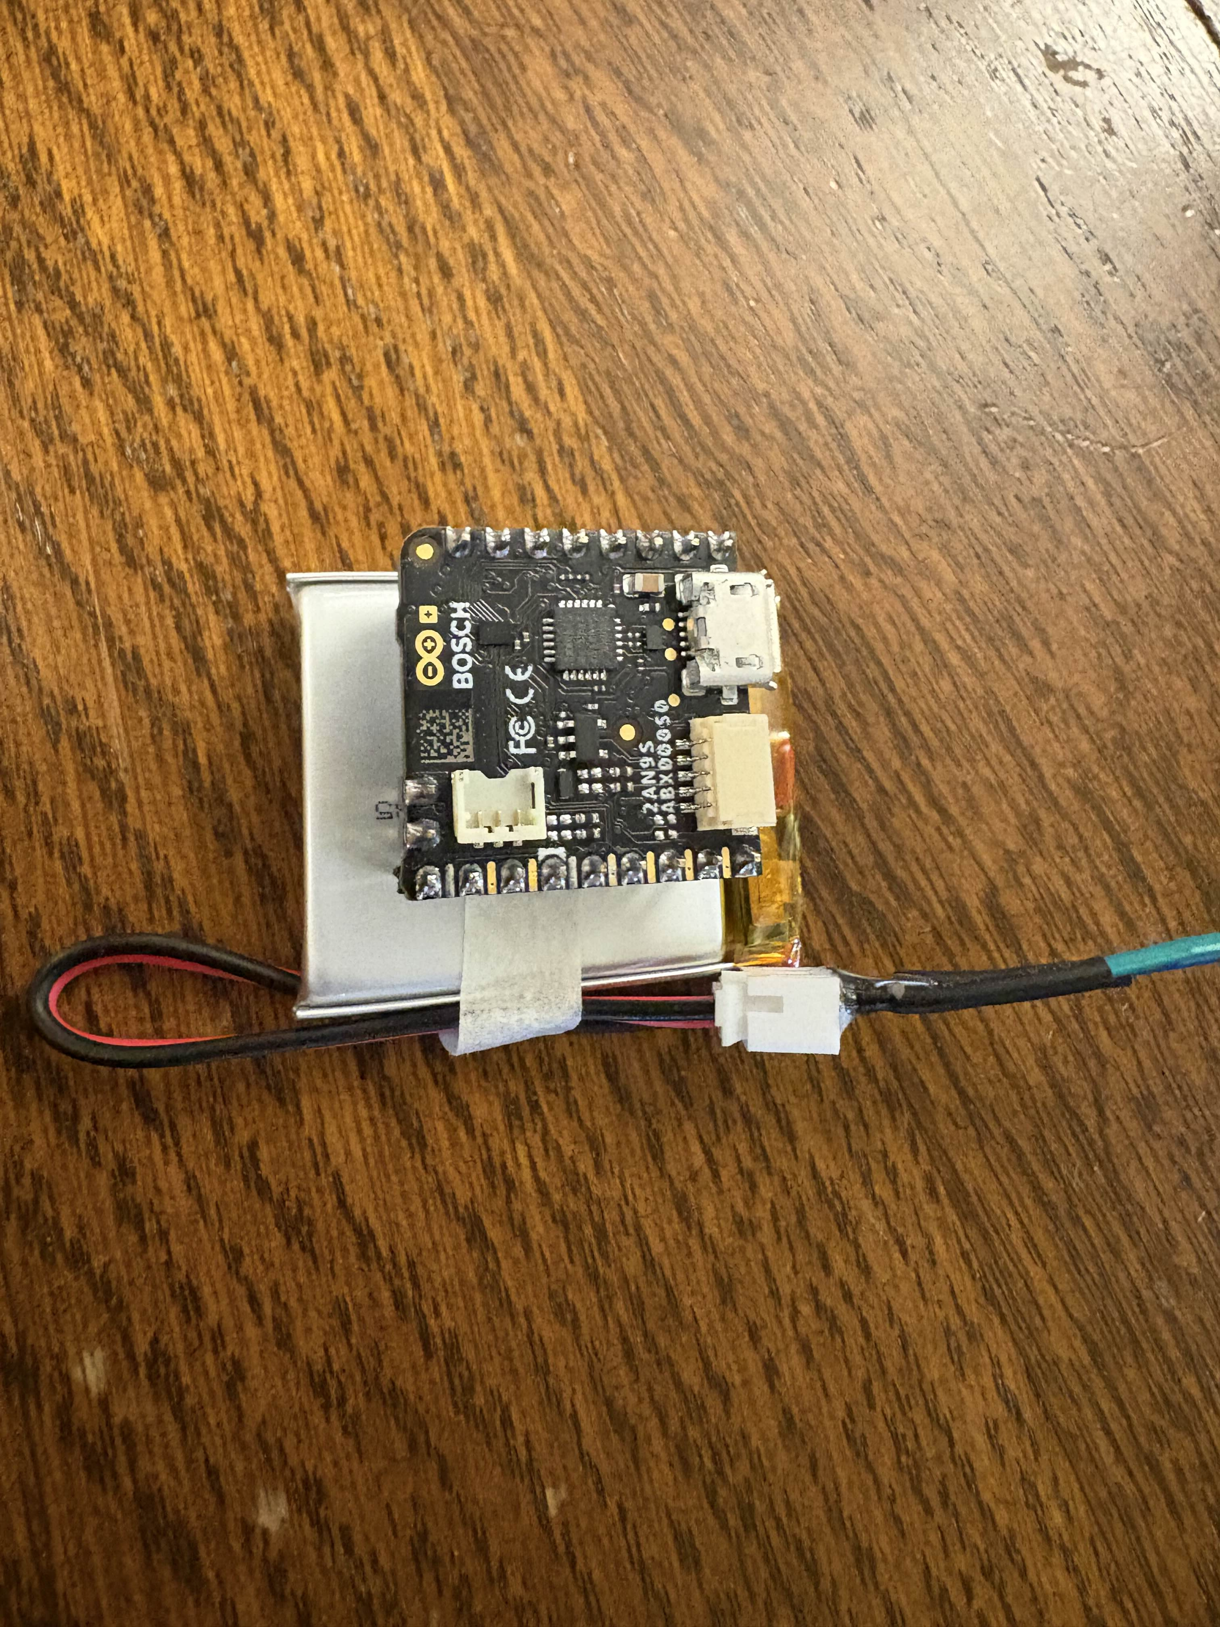
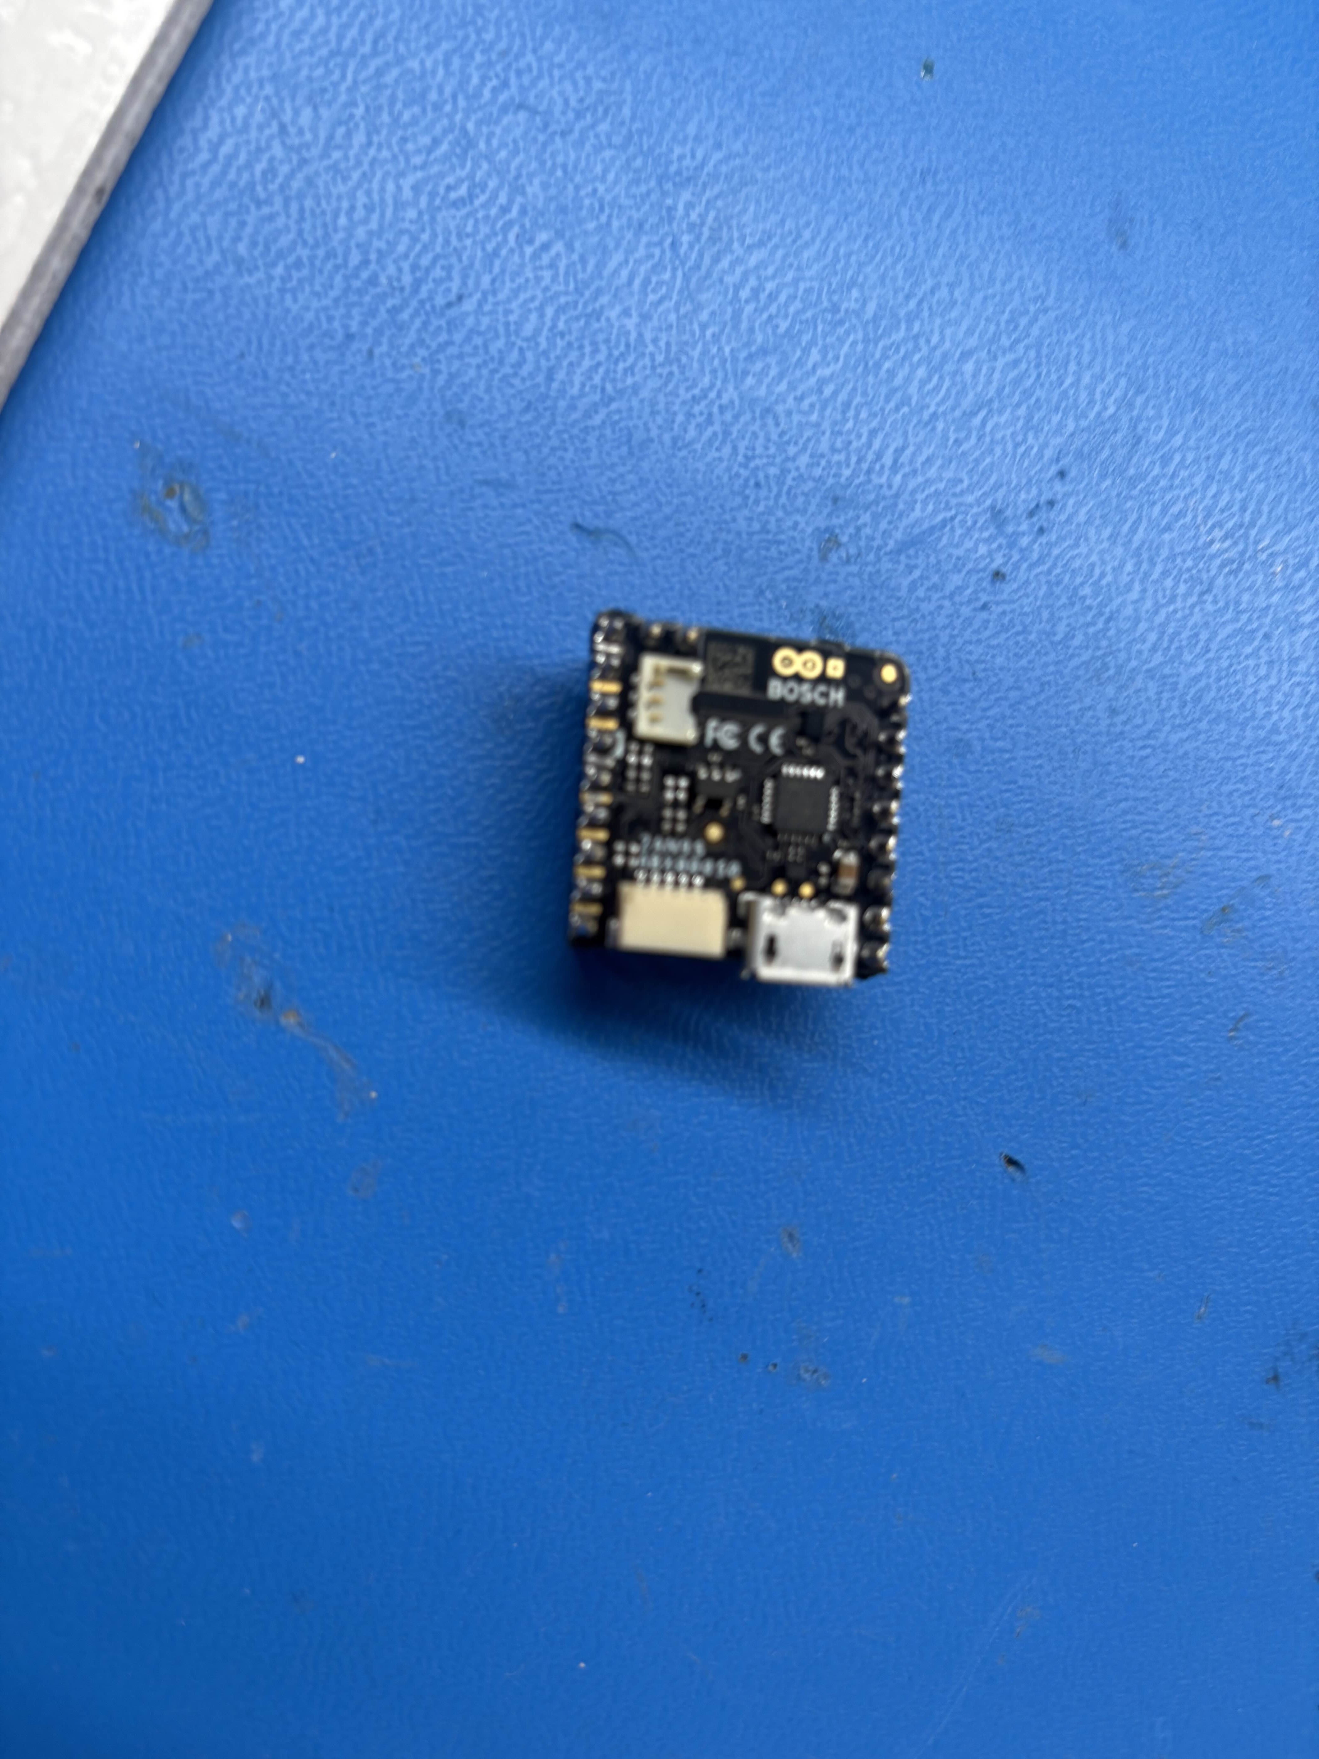
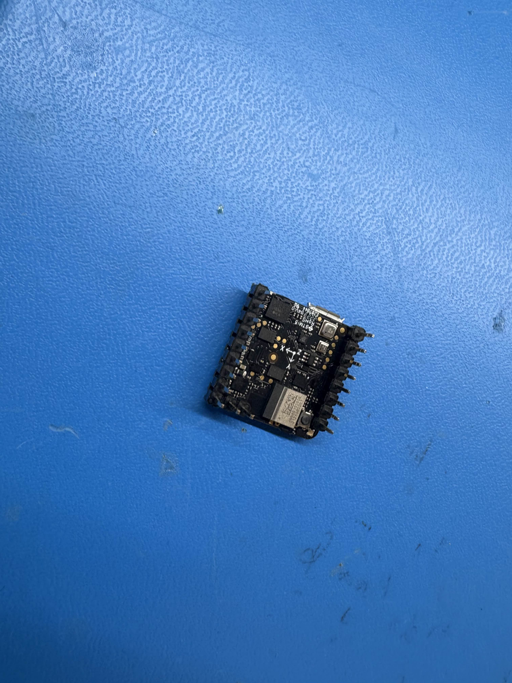
PCB Changes
All IC(s) placed on current PCB
Routing needs to be completed:
Soldering complete for development board:
Battery currently too large for device (Looking into smaller batteries)

Slide 7
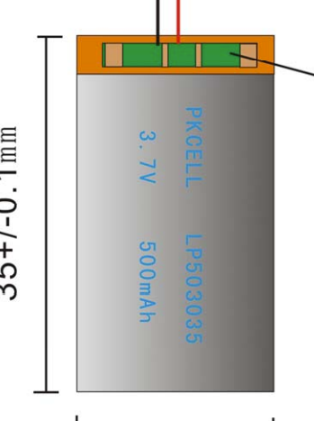
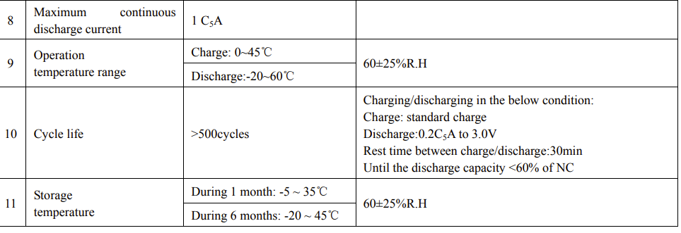
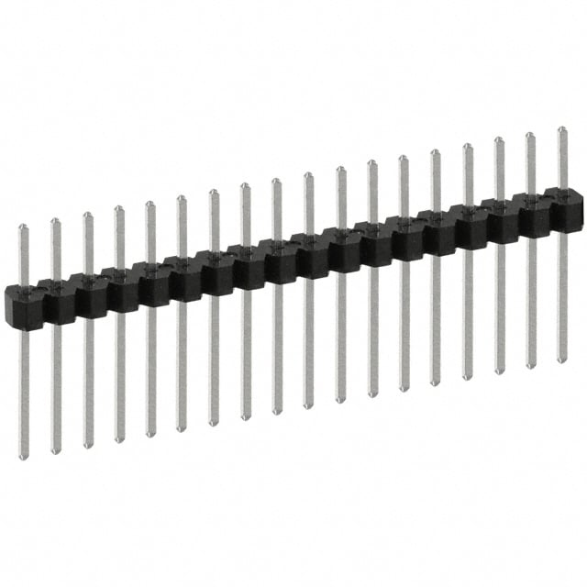
Next Week
Blockers & brief summary of next week’s work
Want to find a smaller area battery
Current Battery: Li-Polymer 503035 500mAh 3.7V with PCM
35 mm x 30 mm (Need 22.86 mm x 22.86 mm)
Rechargable, but very large size:
Looking for short male pin headers (Minimize size)

Slide 8
Thank You
Purdue Polytechnic Institute

